Slide 1
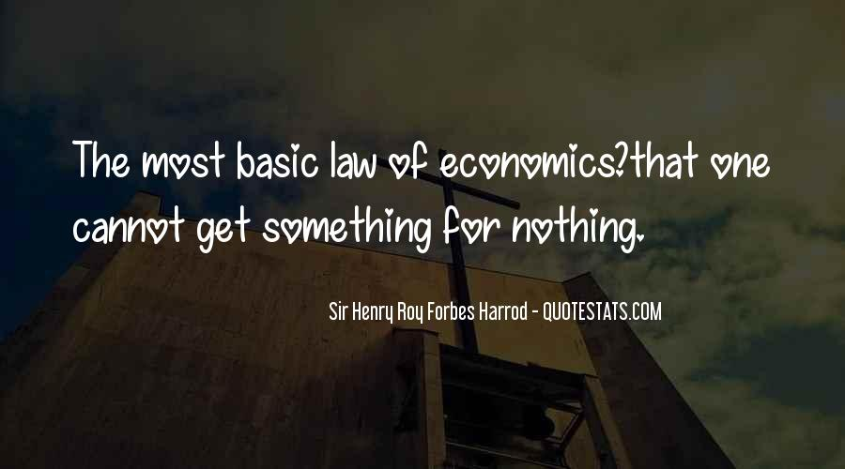

Slide 2
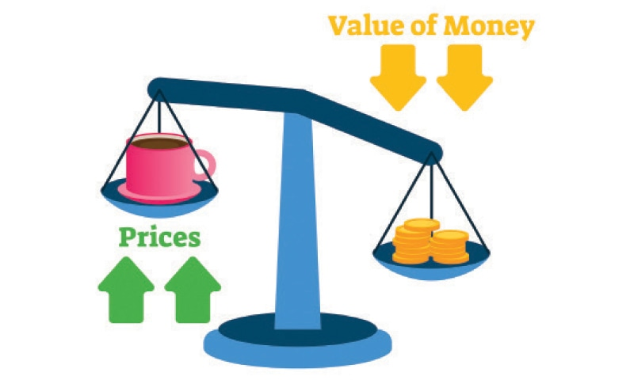
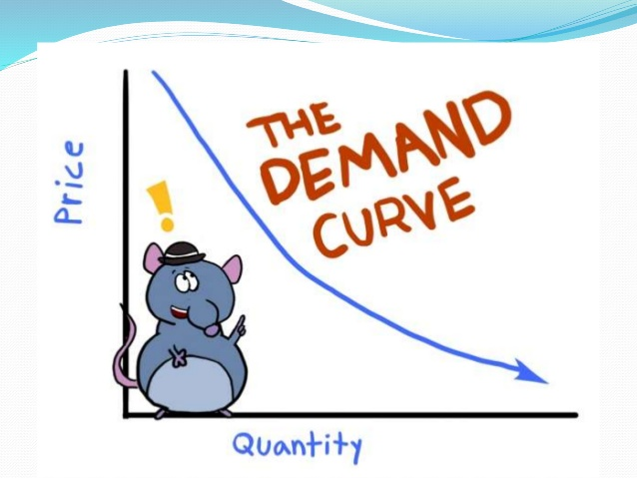
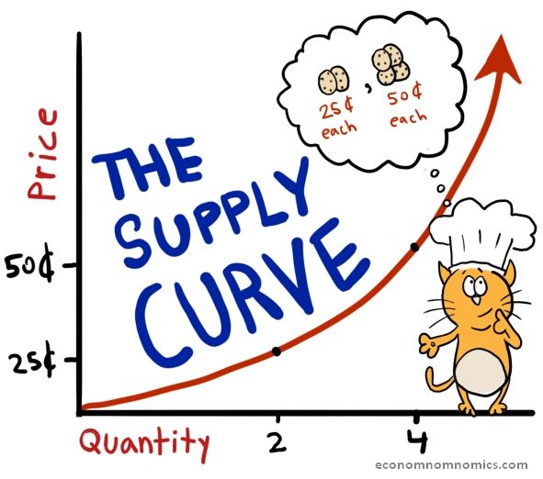


INTRODUCTION TO ECONOMICS
Choices, Choices, Choices, . . .

Slide 3
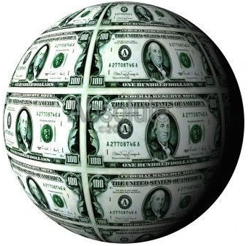

Basic Branches of Economics?
Microeconomics
Study of small economic units
How do individuals/ households/firms etc. make economic decisions
Macroeconomics
Study of the large economy as a whole (Choices made by large groups )
The big picture: National Income, growth, employment, etc.

Slide 4
Basic Branches of Economics?
Positive Economics- Based on facts
Avoids value judgments (what is)
Normative Economics- Includes value judgments (what ought to be)

Slide 5
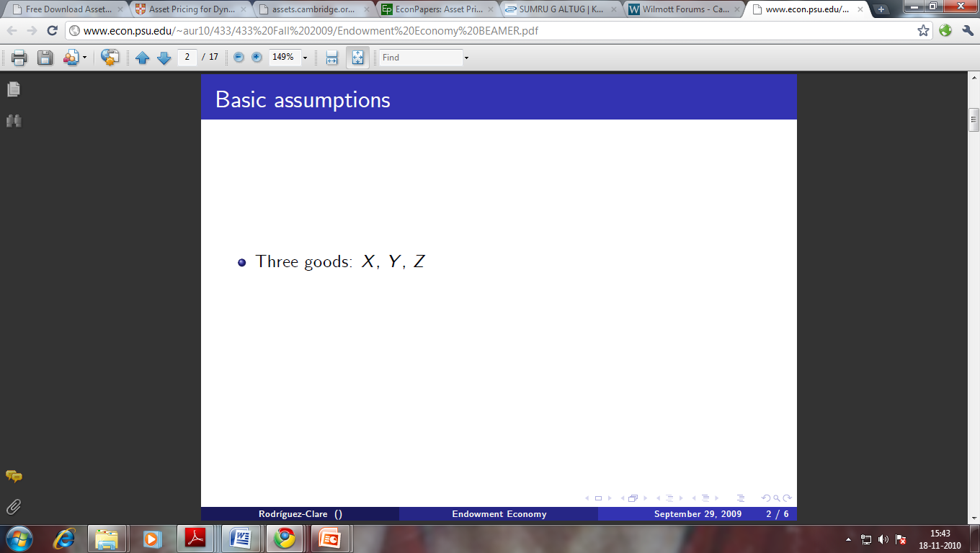
THREE PRINCIPLES OF ECONOMICS
The study of economics has many facets, but it is unified by several central ideas
Don't worry if you don't understand them all at first or if you aren’t completely convinced
We will explore these ideas more fully in later chapters. Consider these central ideas as “preview of coming attractions”
Notes:
Economists therefore study how people make decisions: how much they work, what they buy, how much they save, and how they invest their savings.
Economists also study how people interact with one another. For instance, they examine how the multitude of buyers and sellers of a good together determine the price at which the good is sold and the quantity that is sold. Finally, economists analyze forces and trends that affect the economy as a whole, including the growth in average income, the fraction of the population that cannot find work, and the rate at which prices are rising.

Slide 6

Principles of Economics: Some Central Ideas
People face trade-offs
“There is no such thing as a free lunch!”
Making decisions requires trading
off one goal against another
Notes:
The study of economics has many facets, but it is unified by several central ideas. Don't worry if you don't understand them all at first or if you aren’t completely convinced. We will explore these ideas more fully in later chapters. Consider these central ideas as “preview of coming attractions”.

Slide 7
Cont.
To get one thing, we usually have to give up another thing
Leisure time vs. work
Guns vs. butter
Clean Environment vs. Income
Efficiency vs. equality

Slide 8
Cont.
Efficiency v. Equality
Efficiency means society gets the most that it can from its scarce resources
Equality means the benefits of those resources are distributed fairly among the members of society
Notes:
Telangana CM K. Chandrashekhar Rao has announced a new scheme for unemployed youth of the state named TS Nirudyoga Bruthi. Under this scheme, he announced to provide an amount of Rs.3016/- per month as an unemployment allowance to the unemployed youth of the state. The same scheme is already running in the state of Andhra Pradesh by the name of AP Yuva Neshtam Scheme.

Slide 9
Cont.
2. The cost of something is what you give up to get it
Decisions require comparing costs and benefits of alternatives
Whether to go to college or to work?
Whether to study or go out on a date?
Whether to go to class or sleep in?

Slide 10
Cont.
The next-highest-valued alternative foregone
The opportunity cost of an item is what you give up to get that item
Notes:
College athletes who can earn millions if they drop out of school and play professional sports are well aware that their opportunity cost of college is very high. It is not surprising that they often decide that the benefit of a college education is not worth the cost.

Slide 11
Cont.
College athletes who can earn millions if they drop out of school and play professional sports are well aware that their opportunity cost of college is very high. It is not surprising that they often decide that the benefit of a college education is not worth the cost

Slide 12
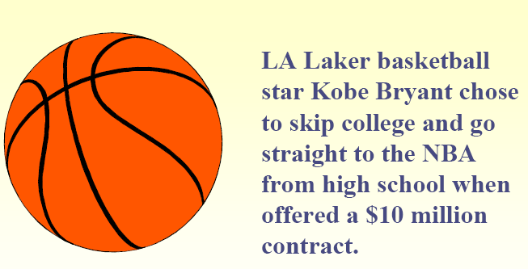
Cont.

Slide 13
Cont.
3. Rational people think at the margin
Marginal changes are small, incremental adjustments to an existing plan of action
People make decisions by comparing costs and benefits at the margin.
Notes:
Economists normally assume that people are rational. Rational people systematically and purposefully do the best they can to achieve their objectives, given the available opportunities. Keep in mind that Margin means “edge,” so marginal changes are adjustments around the edges of what you are doing. Rational people often make decisions by comparing marginal benefits and marginal costs. Water-Diamond paradox.

Slide 14
Cont.
Economists normally assume that people are rational.
Rational people systematically and purposefully do the best they can to achieve their objectives, given the available opportunities.
Rational people often make decisions by comparing marginal benefits and marginal costs.
Water-Diamond paradox.
Notes:
Economists normally assume that people are rational. Rational people systematically and purposefully do the best they can to achieve their objectives, given the available opportunities. Keep in mind that Margin means “edge,” so marginal changes are adjustments around the edges of what you are doing. Rational people often make decisions by comparing marginal benefits and marginal costs. Water-Diamond paradox.

Slide 15
Cont.
4. People respond to incentives
An incentive is something that induces a person to act, such as the prospect of a punishment or a reward. Incentives are crucial to analysing how markets work.
Marginal changes in costs or benefits motivate people to respond
The decision to choose one alternative over another occurs when that alternative’s marginal benefits exceed its marginal costs!
Notes:
An incentive is something that induces a person to act, such as the prospect of a punishment or a reward. Incentives are crucial to analysing how markets work.

Slide 16
Quiz
Describe an important trade-off you recently faced
Give an example of some action that has both a monetary and nonmonetary opportunity cost
Describe an incentive your parents offered to you in an effort to influence your behavior

Slide 17
Cont.
5. Trade can make everyone better off
People gain from their ability to trade with one another
Competition results in gains from trading
Trade allows people to specialize in what they do best
Notes:
Trade allows countries to specialize in what they do best and to enjoy a greater variety of goods and services.

Slide 18
Cont.
6. Markets are usually a good way to organize economic activity
In a market economy, households decide what to buy and who to work for
Firms decide who to hire and what to produce
Notes:
Market Economy - an economy that allocates resources through the decentralized decisions of many firms and households as they interact in markets for goods and services. Here, firms decide whom to hire and what to make. Households decide which firms to work for and what to buy with their incomes. These firms and households interact in the marketplace, where prices and self-interest guide their decisions.

Slide 19
Cont.
Adam Smith made the observation that households and firms interacting in markets act as if guided by an “invisible hand.”
Notes:
In his 1776 book An Inquiry into the Nature and Causes of the Wealth of Nations, economist Adam Smith made the most famous observation in all of economics: Households and firms interacting in markets act as if they are guided by an “invisible hand” that leads them to desirable market outcomes. Smith’s great insight was that prices adjust to guide these individual buyers and sellers to reach outcomes that, in many cases, maximize the well-being of society as a whole.

Slide 20
Cont.
Because households and firms look at prices when deciding what to buy and sell, they unknowingly take into account the social costs of their actions
As a result, prices guide decision makers to reach outcomes that tend to maximize the welfare of society as a whole
Notes:
As per Smith, when the government prevents prices from adjusting naturally to supply and demand, it impedes the invisible hand’s ability to coordinate the decisions of the households and firms that make up the economy.

Slide 21
Cont.
7. Governments can sometimes improve market outcomes
Needed to enforce property rights
When the market fails (breaks down) government can intervene to promote efficiency and equity
Notes:
Property rights is the ability of an individual to own and exercise control over scarce resources. Market economies need institutions to enforce property rights so individuals can own and control scarce resources.

Slide 22
Cont.
Market Failure occurs when the market fails to allocate resources efficiently

Slide 23
Cont.
Market failure may be caused by an externality, which is the impact of one person or firm’s actions on the well-being of a bystander
Notes:
Externalities are a form of market failure. Externalities are defined as the spillover effects of the consumption or production of a good that is not reflected in the price of the good. For example, the production of steel results in pollution being released into the air, but the cost of the pollution to the environment is not reflected in the price of steel.

Slide 24
Cont.
Market failure may also be caused by market power, which is the ability of a single person or firm to unduly influence market prices.
Notes:
For example, if everyone in town needs water but there is only one well, the owner of the well is not subject to the rigorous competition with which the invisible hand normally keeps self-interest in check. In the presence of externalities or market power, well-designed public policy can enhance economic efficiency.

Slide 25
Cont.
8. The standard of living depends on a country’s production
Standard of living may be measured in different ways:
By comparing personal incomes
By comparing the total market value of a nation’s production

Slide 26
Cont.
Almost all variations in living standards are explained by differences in countries’ productivities

Slide 27
Cont.
Productivity is the amount of goods and services produced from each hour of a worker’s time
Higher productivity
Higher standard of living

Slide 28
Cont.
9. Prices rise when the government prints too much money
Inflation is an increase in the overall level of prices in the economy
One cause of inflation is the growth in the quantity of money
When the government creates large quantities of money, the value of the money falls

Slide 29
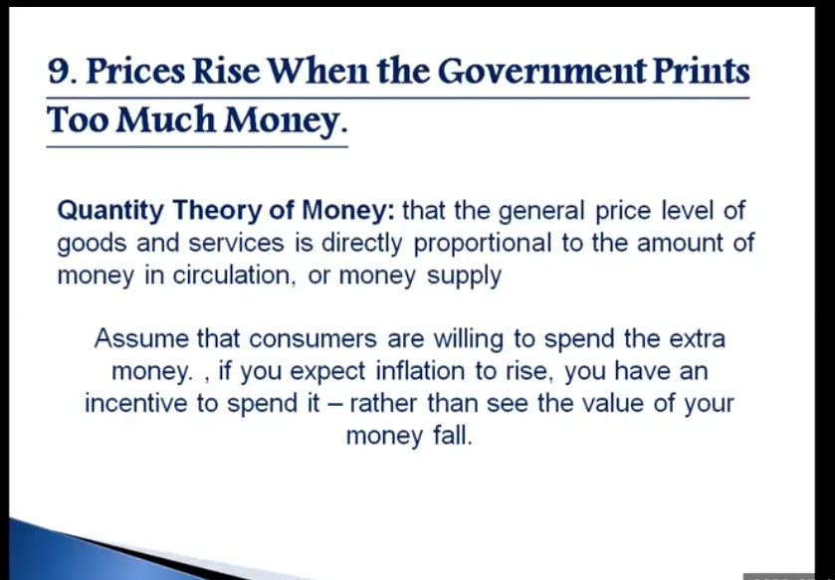
Cont.

Slide 30
Cont.
10. Society faces a short-run trade-off between inflation and unemployment
The Phillips Curve illustrates the trade-off between inflation and unemployment:
Inflation Unemployment
It’s a short-run trade-off!
Notes:
Business cycle are fluctuations in economic activity, such as employment and production.

Slide 31
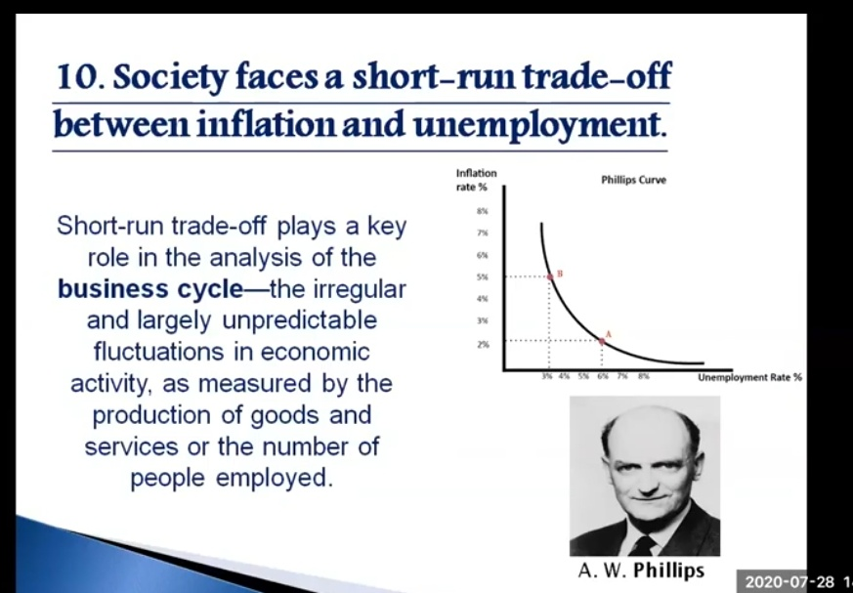
Cont.
Notes:
Business cycle are fluctuations in economic activity, such as employment and production.

Slide 32
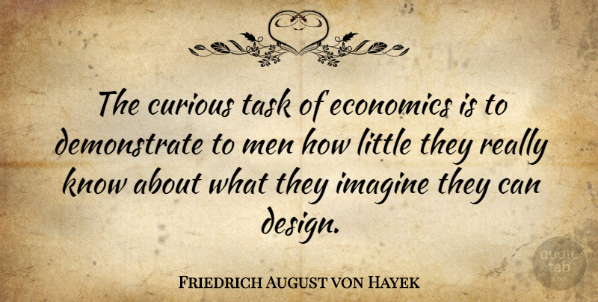
Cont.
...to be continued!!!

Slide 33
THANK YOU
HAPPY LEARNING

